Slide 1
Survival Analysis

Slide 2
Survival Analysis
Set of statistical approaches used to determine the time it takes for an event of interest to occur.
Importance :
1. Medical Field.
2. Predictive Maintenance in Mechanical Operations.
3. Actuaries.

Slide 3
Time to Event
Reflects the time until a participant has an event of interest(heart attack, death, .etc).

Slide 4
Types of Events:
1. Relapse
2. Progression
3. Death

Slide 5
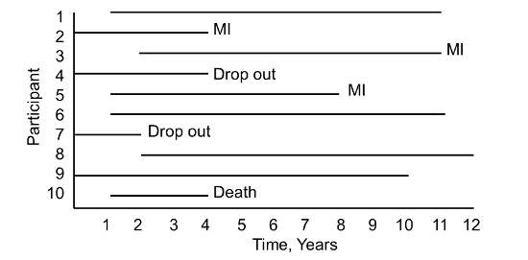
Censoring
If we choose not to include the censored data, then it is highly likely that our estimates would be highly biased and under-estimated.
The inclusion of censored data to calculate the estimates, makes the Survival Analysis very powerful.

Slide 6
Censoring
The event we are interested in does not occur:
1. Right
2. left
3. Interval

Slide 7
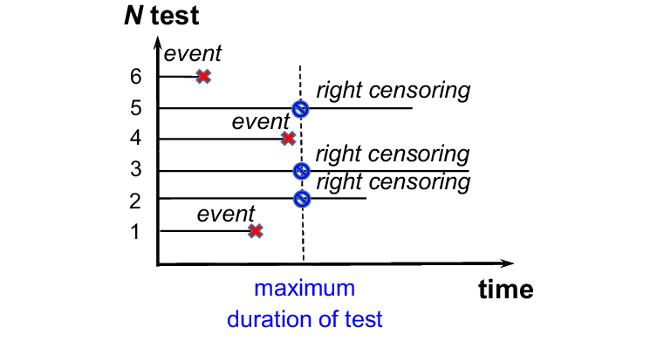
Most common type is Right censoring: This can occur when a participant drops out before the study ends or when a participant is event free at the end of the observation period.

Slide 8
Kaplan-Meier Estimate
Since we don’t have the true survival curve of the population, thus we will estimate the survival curve from the data.
ni: the population at risk at time just prior to time ti
di: number of events occurred at time ti

Slide 9
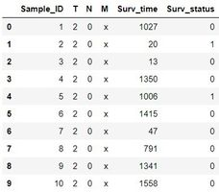
DATA

Slide 10
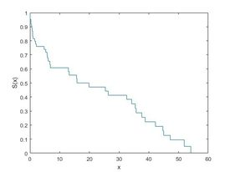
Kaplan Meier Estimator
ecdf(y,'censoring',cens,'function','survivor');

Slide 11
THANK YOU!!

